Slide 1


“Inteligencia sintética ”
Development of the Alexa skill

Slide 2



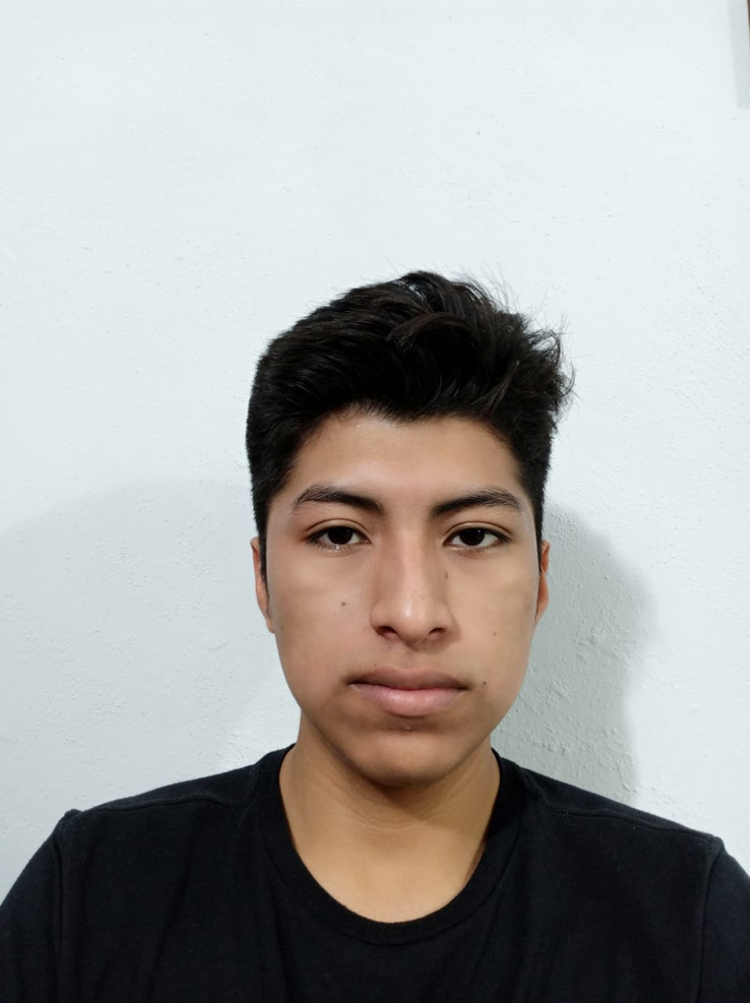
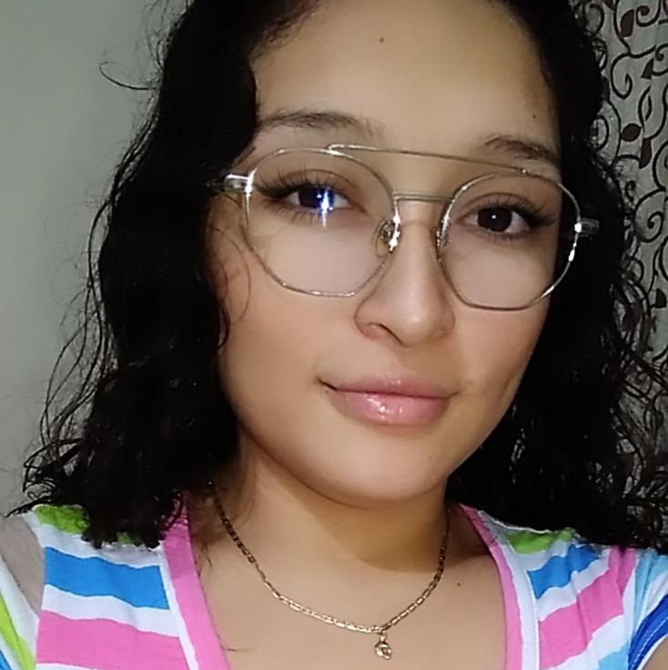
OUR TEAM
Developer
Product Owner
Carlos Sánchez Chuc
Scrum Master
Daniel Pliego Vega
Omar Cauich Pasos
Developer
Emir Bellos Cruz
Developer
Yajani Peraza Alcocer

Slide 3

Progress between deliveries
Second
delivery
Final
delivery
First
delivery
We presented a great investigation on artificial intelligence.
With this research we proceeded to use the Alexa tool to create a skill.
we will deliver a fully functional skill.
Code and we upload the skill to the Amazon Alexa skill store.
our skill met the requirements of the Amazon Alexa skill store.
we were able to deliver our scheduled homework on time.
We define the requirements.
We design the use cases and the user experience.
We did some Alexa testing.
We program the first advance of the skill.

Slide 4

Product phases
Tests
Implementation
Design
Requirements

Slide 5

Requirements
USER
In general, the user requirements of the project are:
curious facts
Accessibility
Frequent questions
Clear explanations
Curious fact of the day
The system requirements are divided into 2 :
Functional requirements
Non-functional requirements
SYSTEM

Slide 6
User Requirements
That the skill tells curious fact about the IA to user.
That users can easily access the skill
That the user can ask easy questions to the skill, such as:
What is AI?
how does it work?
What is it for ?
That the skill answers the questions with a short explanation and understandable to the users.
that the skill give a curious fact in day to the users, by invitation to enter the skill and Hear more curious facts.

Slide 7
System requirements
Functional requirements
In general, the functional requirements are:
Alexa
Introduction
Correct answers
Simple explanations
In general, the
non-functional requirements are:
Devices
Internet
Alexa store
Language
Server
Non-functional requirements

Slide 8
Functional requirements
That the bot Works through Alexa for :
Use your speech recognition algorithms.
To make it accessible on any device that has Alexa.
So that it can be stored on Amazon's servers.
that the skill give an introduction the first time you open it.
That the skill has correct answers and with simple explanations.

Slide 9
Non-functional requirements
for use the skill is need to have Alexa on your device.
Without internet you cannot access the skill.
The skill must have 3 main intents to be accepted in the Alexa store.
The skill will only be in Spanish.
The skill only will accept 1 million requests to the lambda server per month and 5gb of storage on Amazon's servers..

Slide 10
Design
Use cases
Use
case diagrams
Logic
Skill logo
User experience

Slide 11
USE CASES
CU01
CU02
CU03
CU04
Summon the bot | First interaction | Curiosities | Frequently questions
The user start the bot and speech the command for access to he. | Alexa gives a brief introduction, so that the user knows how the Bot works. | Alexa provides a cursory answer regarding the user's question. | The user wants to know the answer to a "Basic" question related to AI, and asks skill to answer his question.

Slide 12
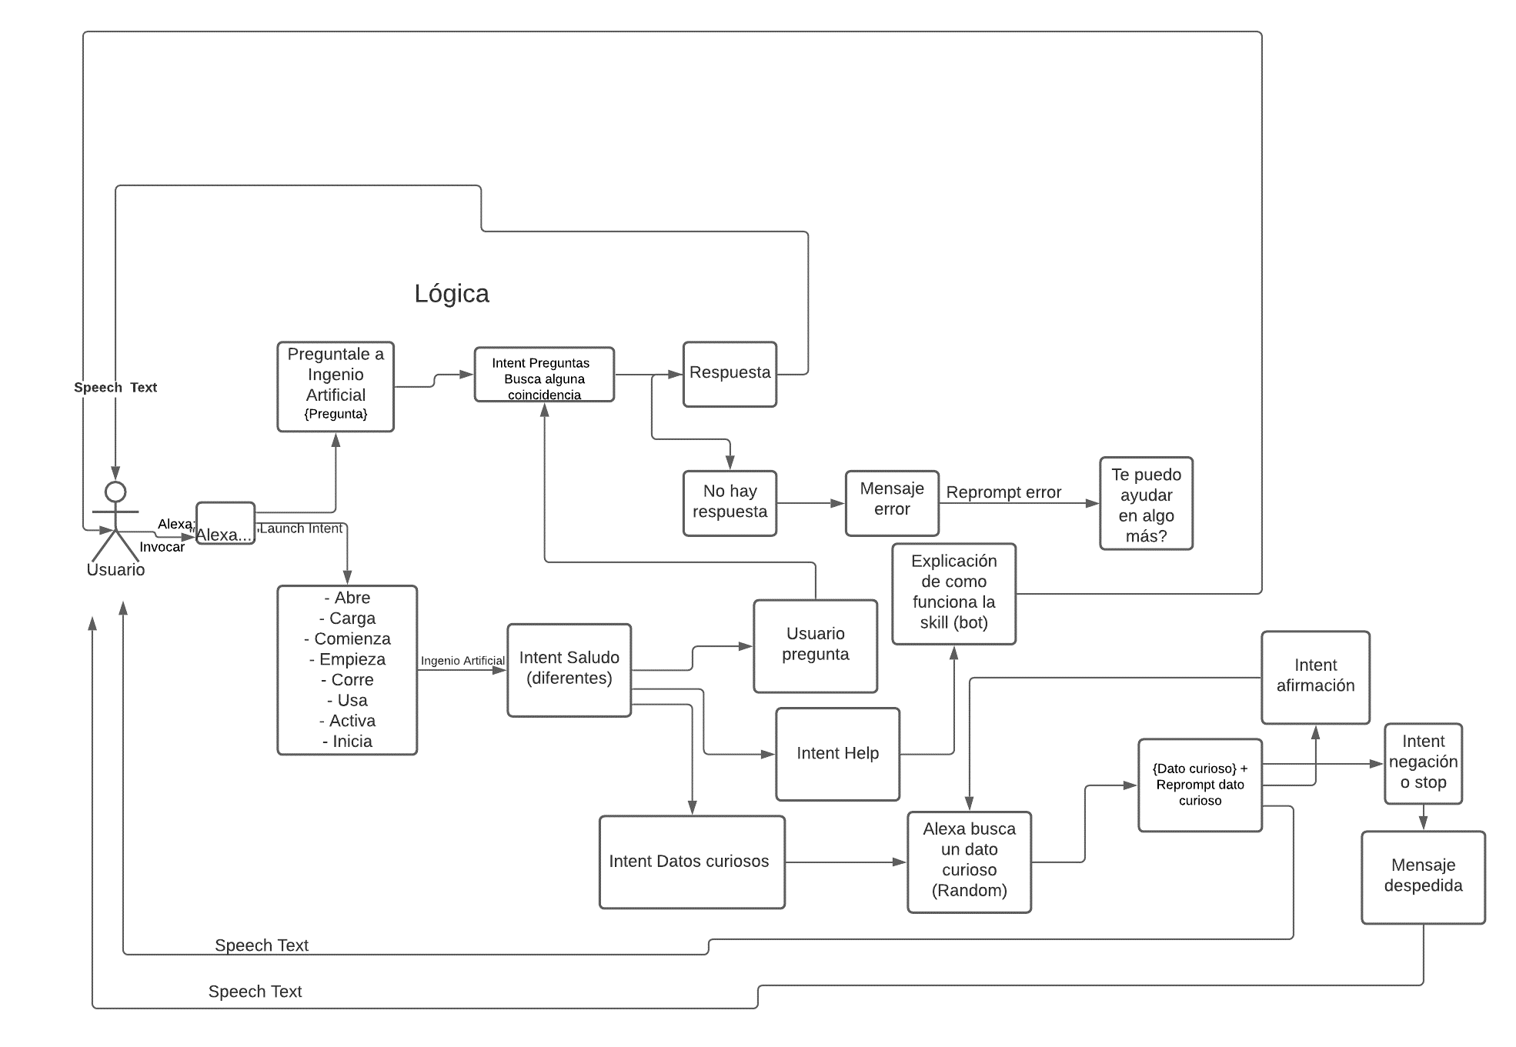
Logic

Slide 13
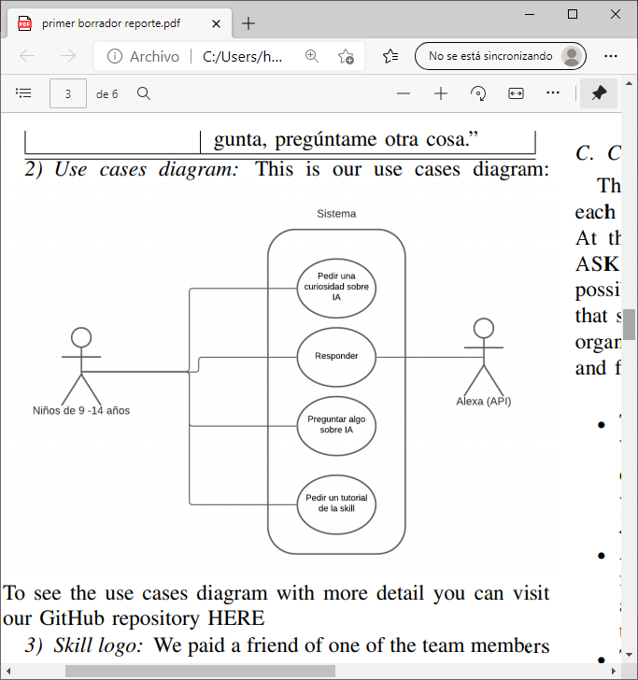
Use case diagrams

Slide 14

Skill logo

Slide 15
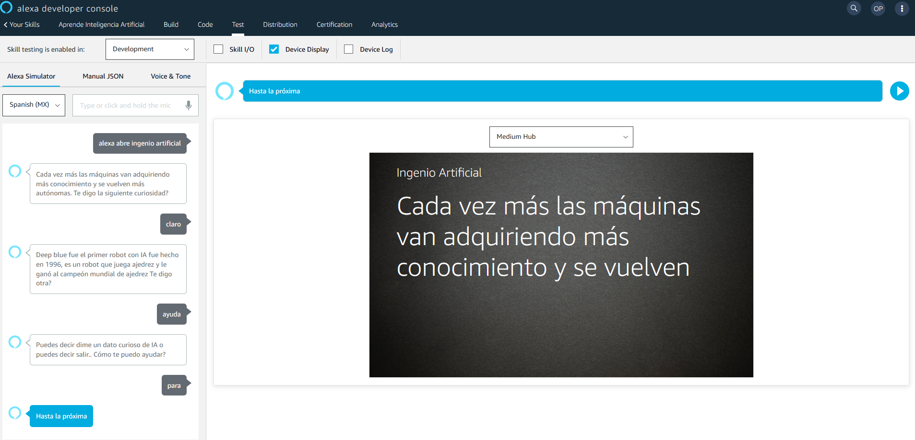
User experience

Slide 16
IMPLEMENTATION (CODING)
1
ASK base code
2
3
Basic Intents (Help, Stop, Negation y GetDatoCurioso)
API
5
Launch intent and introduction
4
Certification

Slide 17
Test
Throughout the project we have carried out 3 types of tests:
Alpha tests: in conducting tests while the system is in development and to verify that what is being developed consistently is correct and useful for the client.
Unit tests: They were carried out in the skill intents, the intentLaunch was tested, to verify that the skill starts when pronouncing the phrase "Alexa, open artificial ingenuity",, Stop, etc.).
Integration tests: It was carried out to verify that the system works correctly, and this led us to implement the subsystem test, which verifies that all the content is correct.

Slide 18


Learned lessons
• Responsibility and punctuality are very important to be able to achieve your goals.
• Keeping everything in order is very important.
• We can do more than we imagine.
• We have much potential.
• Doing a project with a methodology is easier than doing it without one.

Slide 19
Skills acquired
• Analyses the software engineering development as a professional discipline
• Analyses the software engineer profile based on the curricular models
• Analyses the principal methods, technics, procedures, used in the development phases
• Discriminates the software life cycle model at the start of a project
• Identifies the human factors that contribute to the success or failure of the software processes

Slide 20
Course review
For us the course was very entertained, dynamic and very educational, we are satisfied.
Our favorite part was the guest talks because they showed more than theory they also showed us their personal experience and we think that experience of someone that has years working is very valuable.

Slide 21
PROYECT PLAN
we have developed 100% of the planned project
Activities
calendar
monitoring of our project
MONDAY.COM
MONDAY.COM
GITHUB

Slide 22
Contribution

Slide 23
Metrics
To obtain the metric, we first calculate the estimated time, that It will take us to do the homework, then we calculate the difficulty.
The estimated time is measured in hours and the difficulty has 3 possible values:
• Easy: 0.5
• Normal: 1
• Difficult: 1.5
In case the task takes much longer or is more difficult
than estimated, the scrum master will see if it is appropriate to change the metric values ​​of the task.

Slide 24



THANK YOU
Inteligencia Sintética

